Slide 1



Violent Intruder Response
Are You Prepared?
Presented by the
Mt. Lebanon Police Department
in conjunction with the
St. Clair Hospital

Slide 2
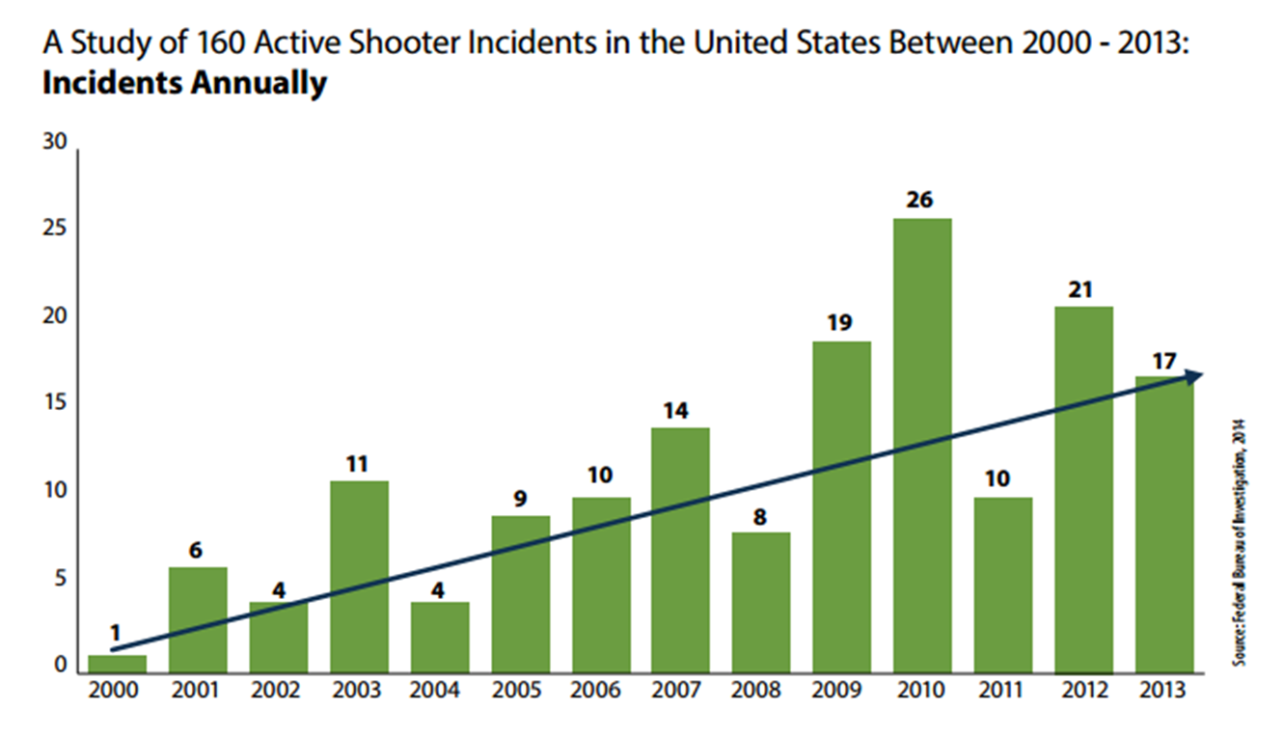

Why are we talking about this?
On average, 20 mass shootings take place in the U.S. every year.
During 2014, there were 14 active shooter incidents at hospitals that left 15 people dead.
Since 2000, 161 people have been killed in hospital shootings.

Slide 3
Why are we talking about this?
36% of these attacks have a duration of
2 minutes or less.
69% have a duration of 5 minutes or less.
If you find yourself in the middle of a senseless attack…the “Why” doesn’t matter.
What matters is…Surviving!

Slide 4
ALiCE
Alert, Lockdown, inform, Counter, Evacuate
Intruder Response

Slide 5

What is:
A proactive, options-based strategy:
Maximizes survivability by teaching options.
NOT sequential steps to follow.
Provides options for SURVIVAL.
Provides KNOWLEDGE so people can make informed decisions.
EMPOWERS employees, visitors and patients to take action as the situation warrants.

Slide 6
ALiCE
Alert

Slide 7
Alert
Information is the key to good decisions.
Alert information can come from anyone.
Provide as much information as possible to as many people as possible.
Use any and all available means: Phone Intercom System, Public Address, Texts, etc.
A small amount of information may save lives!

Slide 8
ALiCE
Lockdown

Slide 9
Lockdown
Excellent starting point.
Not a “one size fits all” solution.
Locked doors provide a time barrier.
Locked doors do make a difference.

Slide 10
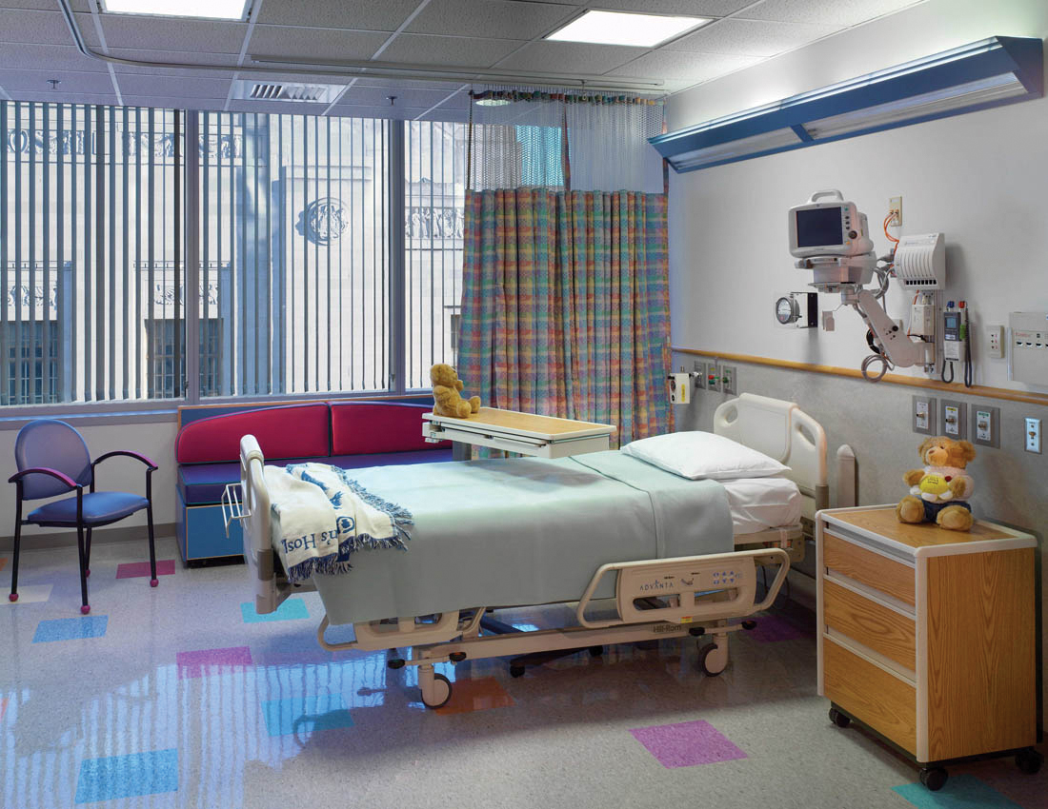
Lockdown
If you determine that Lockdown is your best option:
Make all attempts to secure your location by barricading.
Once barricaded, no one should be allowed to enter your location.

Slide 11
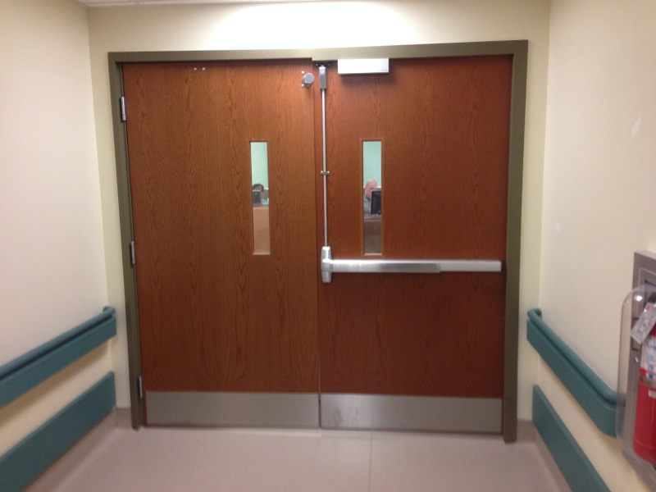

Slide 12
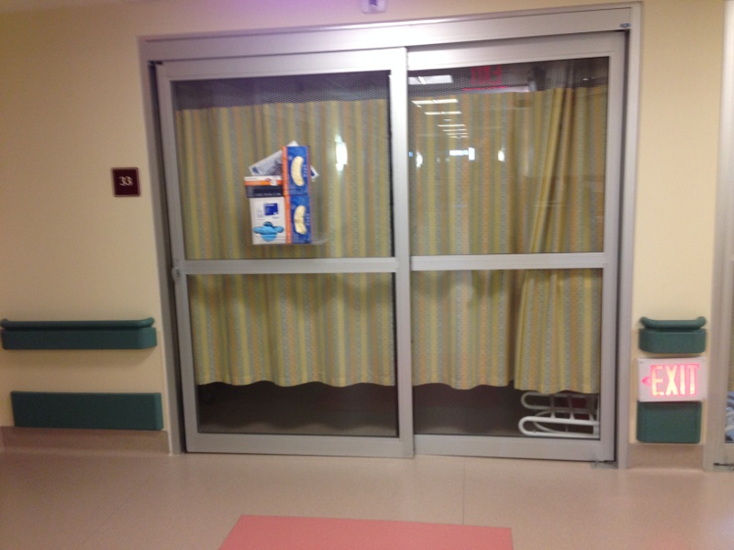

Slide 13
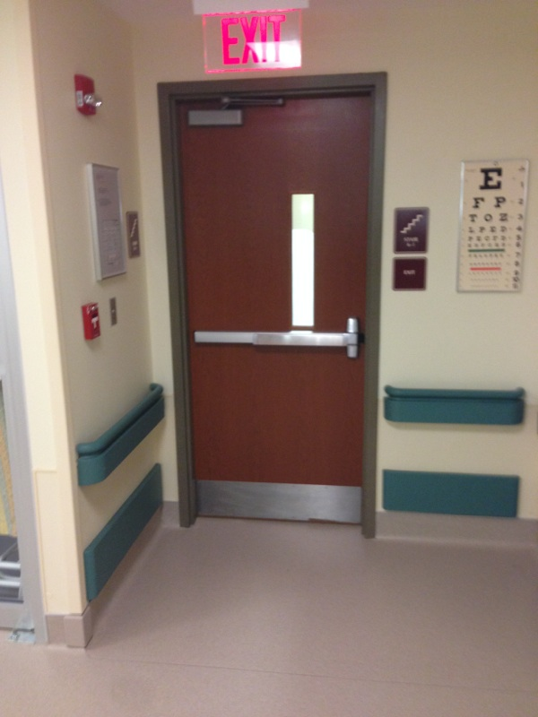

Slide 14
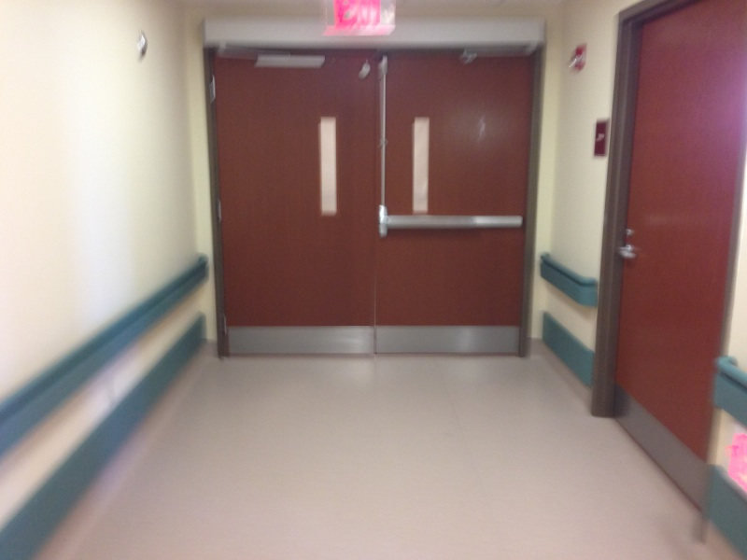

Slide 15
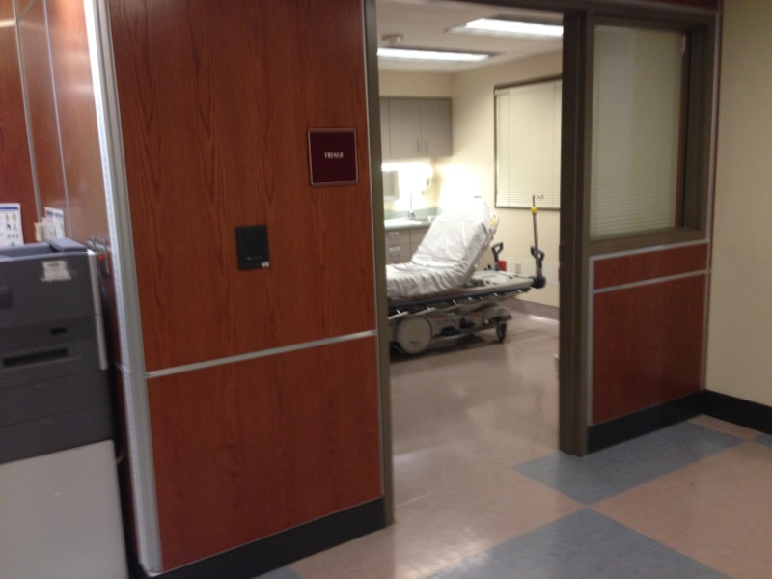

Slide 16
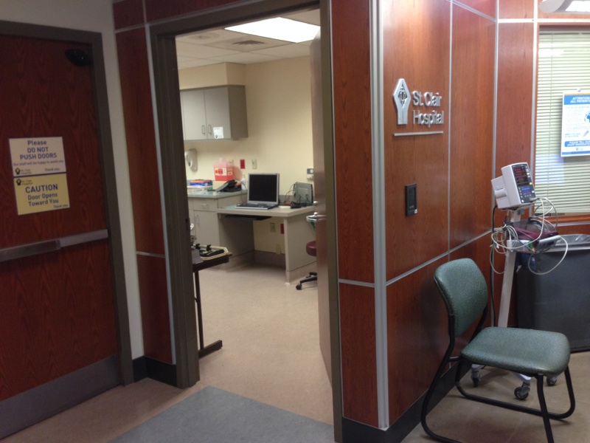

Slide 17
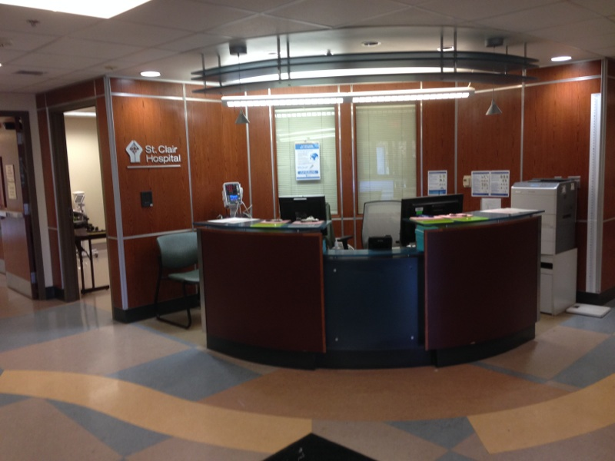

Slide 18
ALiCE
Inform

Slide 19
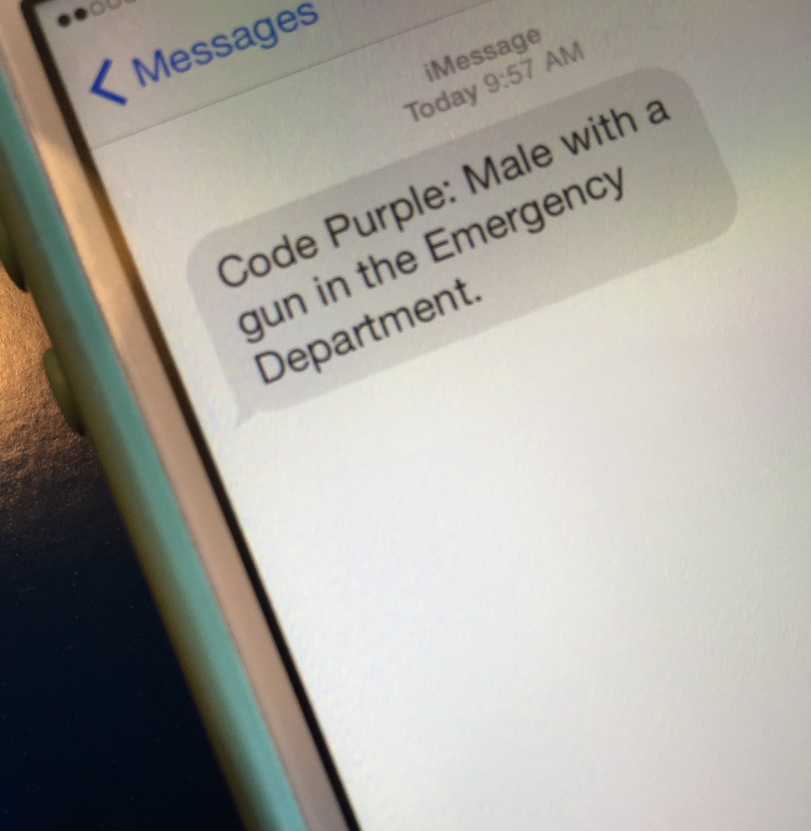
Inform
Continuation of ALERT communication.
If possible, real-time information should be provided by all means available.
Use this information to make single or collective decisions as to the best option for survival.
Be flexible because the situation will be dynamic and fluid.

Slide 20
ALiCE
Evacuation

Slide 21
Evacuate
Only 2% of Violent Intruder events have been by more than one person.
Make decisions based on what is known.
Common Sense…If the intruder is inside, you get outside.

Slide 22
ALiCE
Counter

Slide 23
Counter
You can survive contact with an armed intruder!!
Police miss 70-80% of their shots in dynamic events.
The “bad guy” is not usually a highly skilled shooter.
Used only as a LAST RESORT!

Slide 24
Counter
!!
Engage in acts that disrupt the shooter from shooting accurately(OODA Loop):
Noise (Scream)
Movement (Run Around)
Distance (Run Away)
Distractions (Throw Things)

Slide 25
The ALiCE Response
Presented by the
Mt. Lebanon Police Department
in conjunction with the
St. Clair Hospital

